Slide 1
WADF105 · GROUP- TEAM-04
TCP/IP Communication in Action:
Opening a Secure Website
FCDF-COHORT-11 · Level 1 Semester 1 · 30 Sept 2026
Presented by
Abdulmalik Isah Gaya C11/26/FCDF17171
on behalf of TEAM-04
Notes:
Introduce the scenario: one secure page load looks simple to the user, but it activates every TCP/IP layer from DNS through HTTPS.

Slide 2
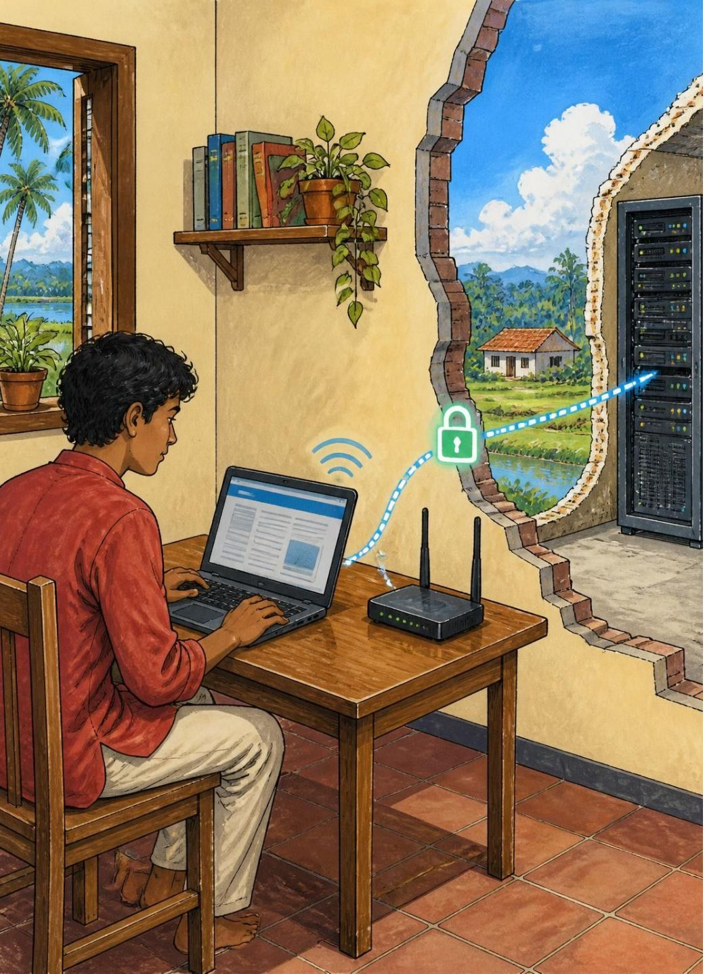
THE SCENARIO
One page load touches every layer of the stack
A user opens https://example.com on a laptop.
Trace the packet from client to web server and back.
It covers DNS, TCP, TLS, HTTP, IP, MAC, ports, and security.
Devices: client laptop, access point/switch, router, internet, firewall, web server.
A single page load activates the complete stack
2
Notes:
Set the route before discussing protocols. The rest of the deck follows this one request from the laptop to the web server and back.

Slide 3
The TCP/IP model has four layers, and each adds its own header
Application · Data = message
1
Services to the user. HTTP, DNS, TLS.
Transport · Data = segment
2
End-to-end delivery, ports, reliability. TCP, UDP.
Internet · Data = packet
3
Logical addressing and routing. IP.
Network Access · Data = frame
4
Physical transmission on the local link. Ethernet, Wi-Fi, ARP.
Key principle: each layer adds its own header, called encapsulation.
3
Notes:
Read downward. The PDU changes as each lower layer adds the information it needs to move the request.

Slide 4
TCP/IP folds OSI's top three layers into one Application layer
OSI model (7 layers) | TCP/IP (4 layers) | Purpose
7 Application, 6 Presentation, 5 Session | Application | HTTP, DNS, TLS, encryption, session
4 Transport | Transport | TCP port numbers, reliability
3 Network | Internet | IP addressing and routing
2 Data Link, 1 Physical | Network Access | MAC addressing, Wi-Fi/Ethernet frames
4
Notes:
The important mapping is at the top: OSI separates application, presentation and session; TCP/IP treats them together as Application.

Slide 5
Four kinds of address get a packet from laptop to server
IP address
MAC address
192.168.1.10 → 93.184.216.34
aa:bb:cc:11:22:33 → router MAC
Routes across networks; changes only at NAT.
Local delivery; changes every hop.
Port numbers
URL / FQDN
54321 → 443 (HTTPS)
https://example.com
Identifies the application process; netstat -an shows it.
Resolved by DNS before the connection begins.
5
Notes:
Contrast the scopes: URL is the human name, DNS finds the IP, IP routes between networks, MAC delivers locally, and ports select the process.

Slide 6





PACKET JOURNEY
The request travels right, the response comes back left
Client laptop
Router
Encapsulation: HTTPS request starts
Routes packet toward internet
Access Point
Internet
Wireless or switch relay
Transit across networks
Direction
Request: client → server · Response: server → client
6
Notes:
Give this slide room. The request crosses local access, routing, the internet and firewall controls before the web server unwraps it. The response returns along the reverse path.

Slide 8
Encapsulation wraps the request on the way down; decapsulation unwraps it at the server
AT THE CLIENT · TOP TO BOTTOM
AT THE SERVER · BOTTOM TO TOP
User types URL, HTTP GET request created
Remove Ethernet
Remove IP
Remove TCP
Decrypt TLS
Deliver HTTP to Apache/Nginx
Generate 200 OK response
1
TLS adds encryption header
2
TCP adds header: src port 54321, dst port 443, sequence number
3
IP adds header: src IP, dst IP
4
Ethernet adds header: src MAC, dst MAC (default gateway), FCS trailer
5
Converted to bits, sent as Wi-Fi radio waves
6
7
Notes:
Emphasise that each layer only reads the information meant for it. The server removes headers in the reverse order and passes the HTTP request to the web software.

Slide 9
Protocol analysis: what each layer does for one page load
Layer | Protocol | PDU | Addressing / fields | Purpose
App | DNS | Query/Response | Query: example.com, Type A | Resolves FQDN to IP 93.184.216.34, uses UDP 53
App | TLS 1.3 | Record | ClientHello, server cert | Encryption, authentication, integrity
App | HTTPS | Request/Response | GET / HTTP/1.1, Host, 200 OK | Transfers web content securely
Transport | TCP | Segment | Ports 54321 to 443, SYN, ACK, SEQ 1000 | Reliable 3-way handshake, ordering
Internet | IP | Packet | Src 192.168.1.10, Dst 93.184.216.34, TTL 64 | Routes packet source to destination
Network Access | Ethernet / Wi-Fi / ARP | Frame | Src MAC, Dst MAC, Type 0x0800 | Delivers frame on the local segment
8
Notes:
Use the table as a protocol checklist. DNS finds the destination, TLS protects the exchange, HTTPS carries content, and TCP/IP/Ethernet move it reliably to the server.

Slide 10
A secure website must use TCP, because UDP would lose parts of the page
TCP
UDP
Reliable, ordered delivery
Fast, best-effort delivery
Connection-oriented: SYN, SYN-ACK, ACK
ACK and retransmission
Ordered; slower; 20-byte header
HTTPS 443, SMTP 587, FTP 21
Connectionless; no handshake
Unordered; fast; 8-byte header
DNS 53, Zoom media, DHCP 67/68
Conclusion
HTTPS needs TCP so page parts arrive reliably and in order.
9
Notes:
TCP adds delay and a larger header, but a browser needs the complete ordered stream. UDP is useful when speed matters more than retransmitting every missing piece.

Slide 11
Troubleshooting a DNS failure: work bottom-up through the layers
Failure: https://example.com shows DNS_PROBE_FINISHED_NXDOMAIN and the page will not load.
Physical: Is Wi-Fi connected? ipconfig /all; do we have an IP?
Connectivity: ping 8.8.8.8; if OK, the internet works.
DNS: nslookup example.com; then nslookup example.com 8.8.8.8.
IP reach: ping 93.184.216.34; IP works but name fails = DNS failure.
Firewall/router: Is port 53 blocked? Check the rule in the NSLAB firewall VM.
Resolution
ipconfig /flushdns; switch DNS to 1.1.1.1 / 8.8.8.8; restart the DNS Client service; check router DNS config.
REFERENCES
IETF RFC 791 (Internet Protocol), RFC 793 (TCP), RFC 8446 (TLS 1.3), ietf.org
Cisco Networking Academy, TCP/IP and OSI Model, cisco.com
Cloudflare Learning Center, How DNS and HTTPS Work, cloudflare.com/learning
AI declaration: AI tool used for diagram generation and draft structuring, verified by the student against official sources.
10
Notes:
Start with the physical connection and move upward. A successful ping to 8.8.8.8 but failed name lookup isolates DNS. Close with the available remediation actions and references.

